Slide 2
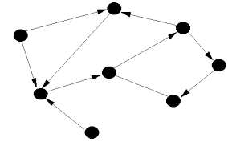
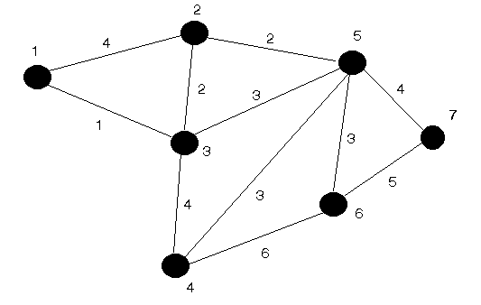
Graphs
-An abstract way of representing connectivity using nodes (also called vertices) and edges
vertices
edges
undirected - weighted
directed

Slide 3
ايه علاقتى بالموضوع
- تحليل الشبكات (network analysis)
- شبكات النقل
- شبكات الأعمال والمشاريع وتقييم برامج المشاريع ومراجعتها
- شبكات السيول والتدفق ألأعظمي (network flow)
- شبكات اقصر مسار (Shortest Path Network)
- تلوين المخططات (graph coloring)

Slide 4
Ok what is the problem???
Graph representation
(how to store the graph in program).
5
4
1
-Adjacency Matrix
-Adjacency List
0
7
3
- Graph Traversal
2
9
-Depth-First Search (DFS) :
uses recursion (stack)
- Breadth-First Search (BFS) :
uses queue
8
6

Slide 5
Graph representation Adjacency Matrix
0,0,1,0,0,0,0,0,0,0,
0,0,0,0,0,1,0,0,0,0,
0,0,0,0,1,0,0,0,0,0,
0,0,0,0,1,0,1,0,0,1,
0,0,0,1,0,0,0,0,0,0,
1,0,0,0,0,0,0,0,0,0,
0,0,0,0,0,0,0,0,1,0,
0,1,0,0,0,0,0,0,0,0,
0,0,0,1,0,0,0,0,0,0,
0,0,0,0,0,0,0,0,0,0,
0 1 2 3 4 5 6 7 8 9
0
1
2
3
4
5
6
7
8
9
5
4
1
0
7
3
2
9
8
6

Slide 6
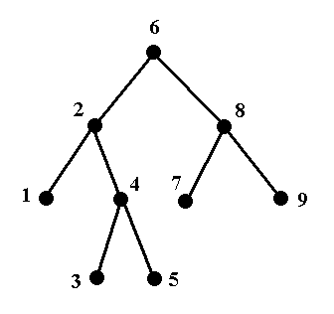
Graph Traversal
Breadth-First Search (BFS)
uses queue
Depth-First Search (DFS) uses recursion (stack)

Slide 7
Depth-First Search (DFS) uses recursion (stack)

Slide 8
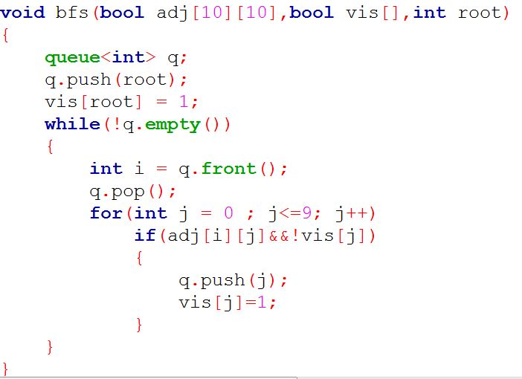
Breadth-First Search (BFS) uses queue

